Slide 1

ECE 281 Lesson 18
Maj Walchko
1

Slide 2
Lesson 18 Outline
Do Time Logs!
Lab 2 Prelab Due BOC LSN 19! << not in prog grade
Review
State Machines
ICE

Slide 3
Blocking Statement Example
process(A, B)
variable tmp : STD_LOGIC;
begin
tmp := '0';
tmp := tmp or A;
tmp := tmp or B;
Y <= tmp;
end process;

Slide 4
NonBlocking Statement Example
process(A, B)
signal tmp : STD_LOGIC;
begin
tmp <= '0';
tmp <= tmp or A;
tmp <= tmp or B;
Y <= tmp;
end process;

Slide 5
VHDL – What we have talked about
Entity – Defines inputs and outputs of box
Architecture – Describes what is inside the box
Two Types of Architecture:
Behavioral – Describes what module does in terms of the relationships between inputs and outputs
Structural – Describes what a module does in terms of how it is composed of simpler modules

Slide 6
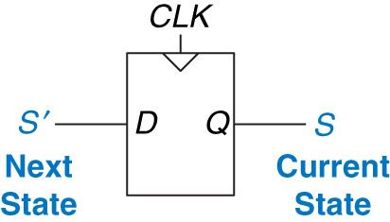
Flip-Flops and Finite State Machines
Flip Flops Create Memory
On the Clock Edge!
Figure 3.20 Flip-flop current state and next state
Copyright © 2013 Elsevier Inc. All rights reserved.

Slide 7
Finite State Machines – Design/Analysis
State Machines:
0) Description
1) State Transition Diagram
2) State Transition Table & Output Table
3) Next State and Output State Equations
4) Schematic
Design
Analysis
Copyright © 2013 Elsevier Inc. All rights reserved.

Slide 8
Finite State Machines - Moore vs Mealy Machine
Moore Machine – outputs depend only on current state of the machine.
Mealy Machine – outputs depend on both the current state and current inputs of the machine.
Clock
Next
State
Current
State
Inputs
M
Combinational Logic or
Next State Logic
K
Flip Flops
K
Output Logic
N
Outputs
Clock
Next
State
Current
State
Inputs
M
Combinational Logic or
Next State Logic
K
Flip Flops
K
Output Logic
N
Outputs

Slide 9
State Machines
Draw State Machine for Stoplight
Clock
Next
State
Current
State
Inputs
M
Combinational Logic or
Next State Logic
K
Flip Flops
K
Output Logic
N
Outputs

Slide 10
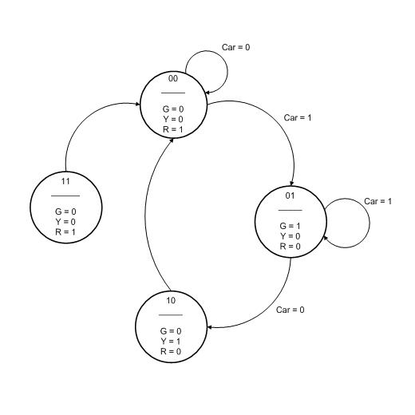
Implement Stoplight
Is this the best reset/glitch transition?

Slide 11
Enumerate Data Types
// C
typedef enum {
int s_red;
int s_green;
int s_yellow;
} sm_stoplight;
-- vhdl
type sm_stoplight is (s_red, s_green, s_yellow);
signal next_state, current_state : sm_stoplight;
Now we can use the new data type “sm_stoplight” in our code

Slide 12
Next State Flip Flop
process (clk, reset)
begin
if reset = '1' then
current_state <= s_yellow;--Reset state
elsif (rising_edge(clk)) then
current_state <= next_state;--Next state becomes current state
end if;
end process;

Slide 13
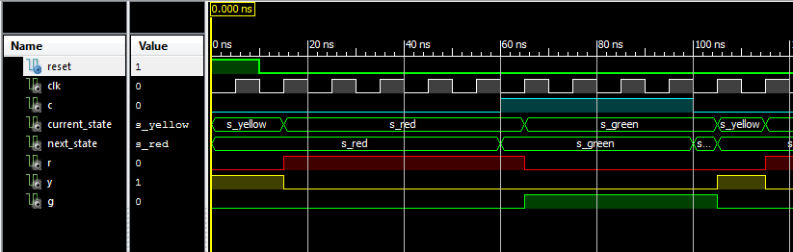
Waveform
Does it look right??

Slide 14
Case Statements
process (current_state, C)
begin
case current_state is
when s_red =>
If C = ‘1’ then
next_state <= green;
else
next_state <= s_red;
end if;
when state2 =>
-- Sequential Statements
when state3 =>
-- Sequential Statements
when others =>
-- Sequential Statements
end case;
end process;

Slide 15
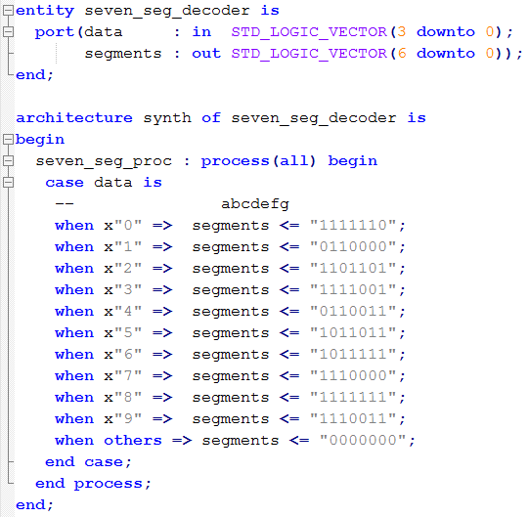
Case Statements – 7SD (combinatorial***)
Selected signal assignments would work just as well…
Important!***

Slide 16
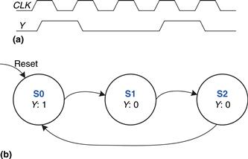
Divide-by-3 Counter – Example 3.6
The waveform and state transition diagram for a divide-by-3 counter is shown in Figure 3.28
Next State Table
Current State | Next State
S0 | S1
S1 | S2
S2 | S0
Output Table
Current State | Output
S0 | 1
S1 | 0
S2 | 0

Slide 17
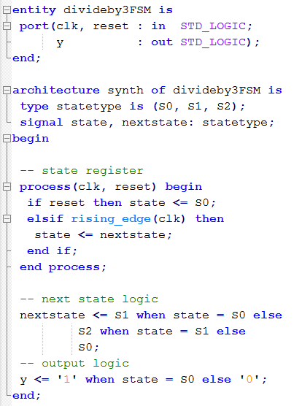
Divide-by-3 Counter – Example 3.6
Next State Table
Current State | Next State
S0 | S1
S1 | S2
S2 | S0
Output Table
Current State | Output
S0 | 1
S1 | 0
S2 | 0

Slide 18
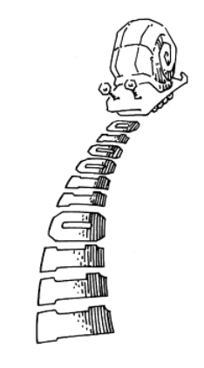
Homework – Review Book Example
Take a look at how the book implements “01”
Example 3.7 on p 132
A Snail is crawling across a sequence of numbers and he smiles if the last 2 numbers are “01”
Sequence: 0100110111

Slide 19
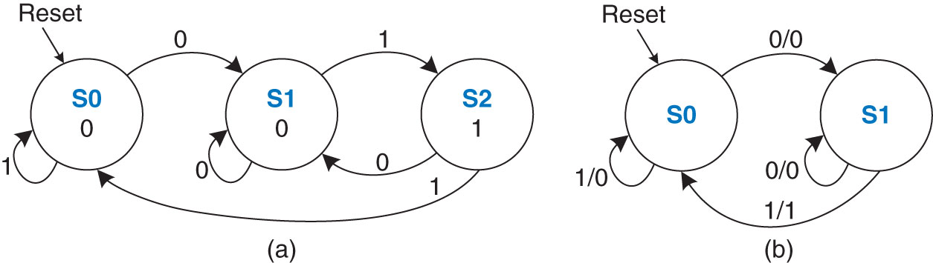
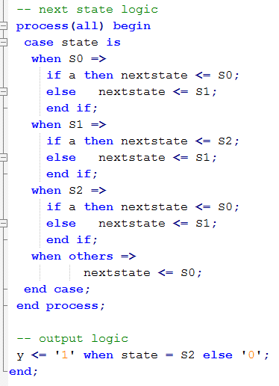
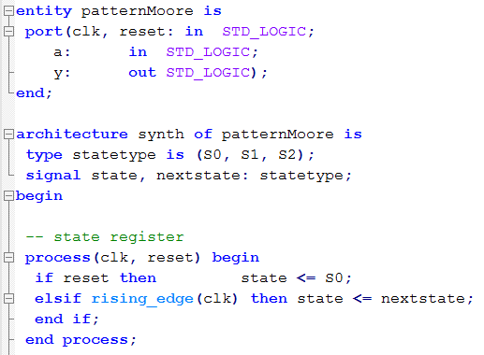
Homework – Review Book Example

Slide 20
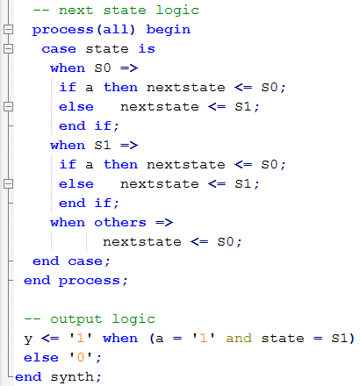
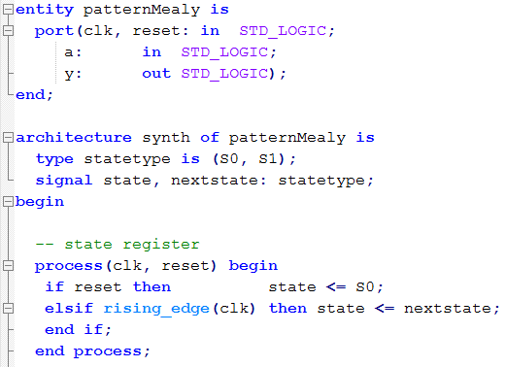
Homework – Review Book Example

Slide 21

21

Slide 22
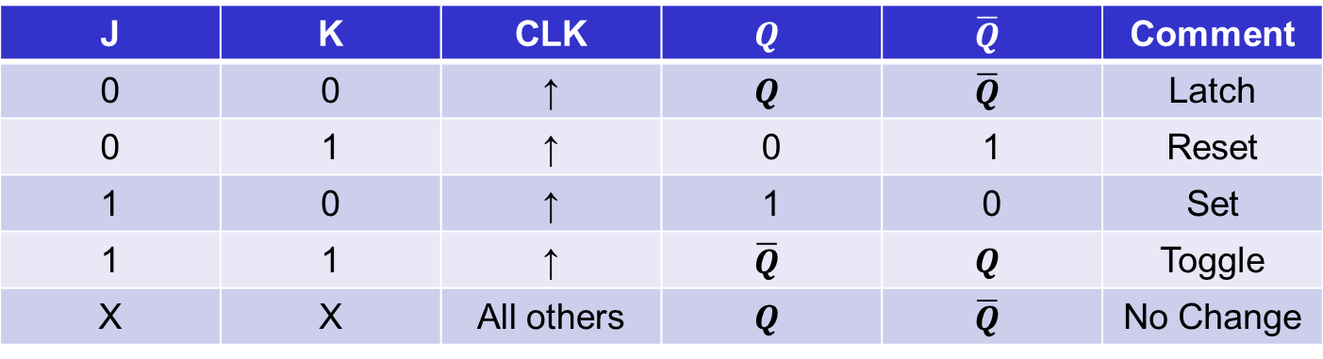
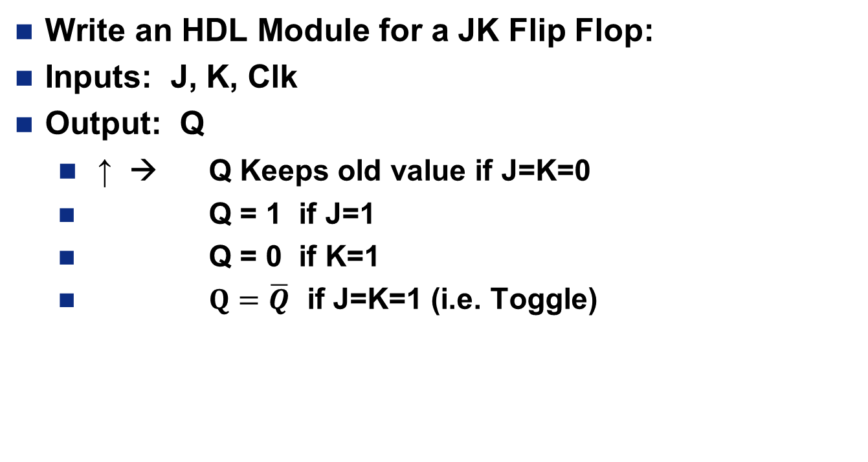
In Class Exercise #1:
Write an HDL Module for a JK Flip Flop:
Inputs: J, K, Clk
Output: Q
↑ → Q Keeps old value if J=K=0
Q = 1 if J=1
Q = 0 if K=1
$Q=\overline{Q}$ if J=K=1 (i.e. Toggle)
J | K | CLK | $$Q$$ | $$\overline{Q}$$ | Comment
0 | 0 | ↑ | $$Q$$ | $$\overline{Q}$$ | Latch
0 | 1 | ↑ | 0 | 1 | Reset
1 | 0 | ↑ | 1 | 0 | Set
1 | 1 | ↑ | $$\overline{Q}$$ | $$Q$$ | Toggle
X | X | All others | $$Q$$ | $$\overline{Q}$$ | No Change

Slide 23
Testbenches
Assert (check output)
Report (report message)
Severity (Error, Warning, Note, Failure)
A <= '0'; B <= '0'; C <= '0'; D <= '0' ; S <= "00";
wait for 10 ns;
ASSERT Y = '1' REPORT "Test 0000 00 Failed" SEVERITY ERROR;
-- Can use Error, Warning, Note Failure
Be Careful with its use: What could be an issue?
Propagation Delay

Slide 24
Component Declaration and Instantiation
How Many of you have investigated your testbenches?
Declaration: In Architecture…Before Begin (Make Known)
component Component_Name
port ( -- signal_name : mode signal_type;
Input0, Input1 : in std_logic;
Output :out std_logic);
end component;
Instantiation: In Architecture…After Begin (Component Used)
Component_Label: Component_Name
port map ( -- Port_name => Signal name,
Input0 => a,
Input1 => b,
Output => Y);

